Slide 1

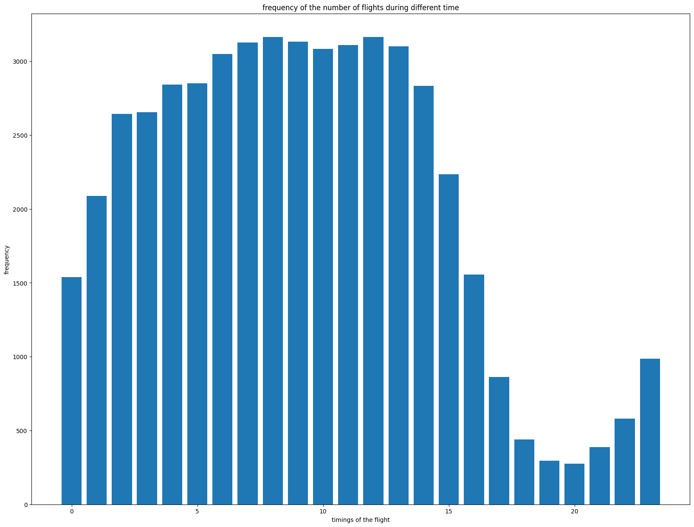
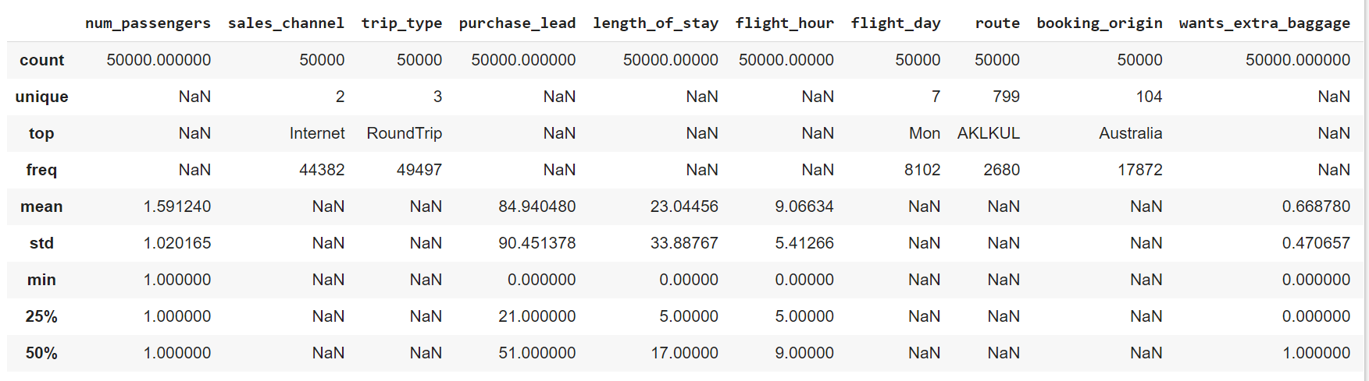
BRITISH AIRLINES
Frequency vs the timing of the flight
Descriptive statistics of the data

Slide 2

Performance on cross-validation data
Accuracy: 0.8384666666666667
Recall: 0.8568560946909393
Precision: 0.972121878435684
F1-Score : 0.9108568485339023
The probability of completion of booking is more related to
Purchase lead
flight duration
length of stay
Click on the icon for GitHub repo of the entire task

